Slide 1

Financial Data Set Report Overview
This report provides a comprehensive analysis of the financial data set encompassing key metrics, trends, and insights crucial for informed investment and operational decisions. Our goal is to present complex financial information with clarity and precision to enable stakeholders and analysts to assess performance effectively.
We will explore revenue streams, expense breakdowns, profitability measures, and growth projections, complemented with visual data to support strategic decision-making and forward planning.

Slide 2
DATA ANALYST INTERNSHIP
BY :RIDHIMA KHAJANCHI

Slide 3
Revenue Analysis
Quarterly Revenues
Revenue Streams
Reviewing the quarterly revenue figures reveals consistent growth across all segments, driven primarily by expanding digital sales and subscription models. This sustained increase evidences robust market demand and effective sales strategies.
Product Sales: 60% of total revenue
Subscriptions: 25% contribution with rapid growth
Services: Remaining 15% with steady performance

Slide 4

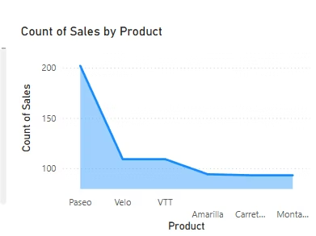
Expense Breakdown
Operational Costs
These costs constitute the largest expense category, including manufacturing, logistics, and administration, showing moderate growth tied to scaling operations.
Research & Development
Investment in innovation remains high, reflecting company priorities to stay competitive and drive long-term growth.
Marketing & Sales
Spending here aligns with efforts to expand market share and supports increased brand visibility.
General & Administrative
Includes overhead and corporate governance costs, maintained within budget limits for operational efficiency.

Slide 5
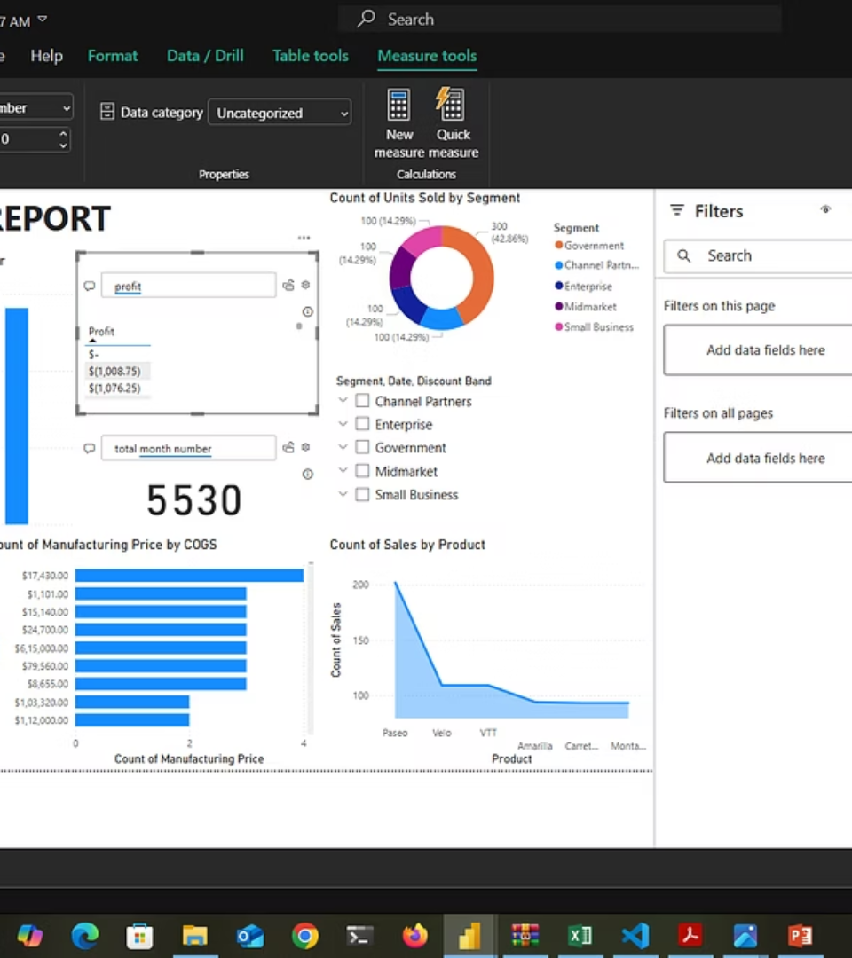
Profitability Metrics
Gross Margin
Steady improvement reflecting optimized production and pricing strategies.
Operating Income
Increased due to controlled expenses and revenue growth synergy.
Net Profit
Positive trajectory with tax efficiencies and reduced financing costs.

Slide 6

Cash Flow and Liquidity Position
1
Operating Cash Flow
Consistently positive, driven by improved collections and cost management.
2
Investing Activities
Investment in capital expenditures aligned with growth plans balanced with asset divestitures.
3
Financing Activities
Managed debt repayments and equity financing contributing to liquidity stability.

Slide 7
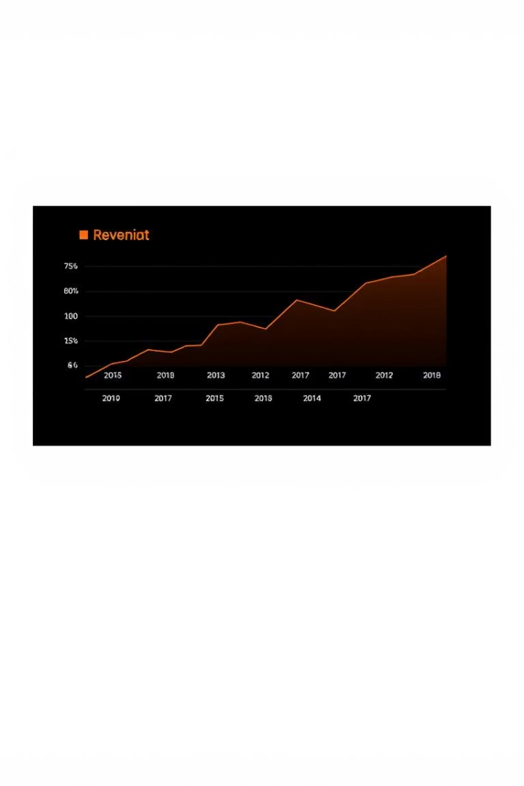



Growth Projections
Year 1-2
Focus on expanding product lines and scaling subscription service adoption.
Year 3-4
Enhancement of operational efficiency and diversification of revenue streams.
Year 5
Consolidation and optimized profitability through market leadership.

Slide 8
Risk Factors and Mitigation
Market Volatility
Regulatory Compliance
Supply Chain Disruptions
Potential impact from economic fluctuations mitigated via diversified product portfolio and geographic presence.
Proactive compliance and monitoring programs in place to reduce legal and reputational risks.
Robust supplier diversification strategy and inventory management minimize operational interruptions.

Slide 9

Key Takeaways and Next Steps
Strong Financial Performance
Firm demonstrates clear revenue growth and profitability improvements with sound expense control.
Investment in Growth
Continued commitment to R&D and market expansion offers promising prospects.
Risk Management
Effective strategies are in place to mitigate key financial and operational risks.
Strategic Recommendations
Focus on scaling subscription services, enhancing operational efficiency, and exploring new markets in the coming quarters.

